Slide 1
Toward an Experimental Metadata Model
Matthew Brush
May 19, 2015
*work funded by Elsevier

Slide 2
Goals
A data model to structure rich, interoperable, semantic metadata about research objects (datasets, protocols, experimental records, publications)
Support collection of experimental metadata in Elsevier systems (ELN, research object repository, data search portal)
Support data and search integration across systems and domains
Be adopted/matured into a community standard (used by or mapped to by other systems/data)

Slide 3
Use Cases
Metadata collection
Strikes a balance between simplicity and richness . . . maximal utility from minimal curation burden
2. Discovery
Support discovery of research artifacts based on their general and experimental attributes
3. (Meta) Analysis
Use the metadata to learn about how research is done and how it can be improved (e.g. discover and analyze trends/patterns in practice of research)

Slide 4
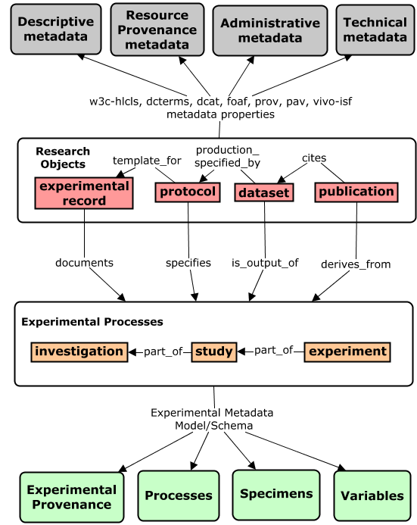
Metadata Framework
General
Metadata
Title, Contributors, Identifiers, Creation/Modification Dates, Version, Access Info, File size, File Format, Keywords
Directly describes research objects
Two Components of a Research Object
Metadata Model
Experimental
Metadata
Indirectly describes
research objects by describing experiments related to them

Slide 5
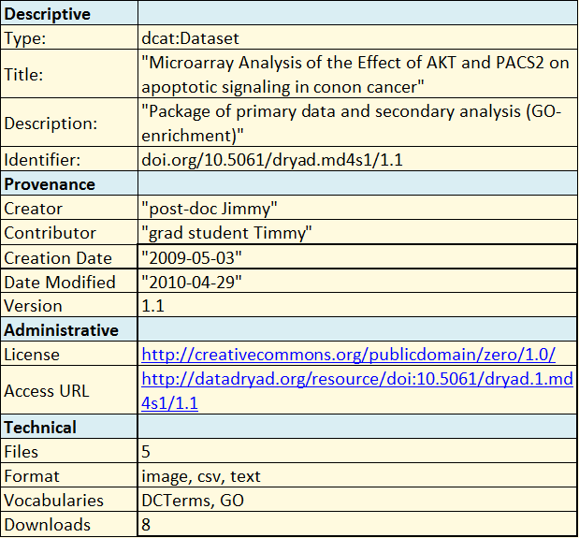
General Metadata Models
Describe general features of the research object
descriptive
provenance
technical
administrative
Typically flat, simple, majority of elements are domain neutral.
Many existing standards to use and specification to follow
Our task is to decide what attributes to describe, what existing standards to re-use, & where new modeling is needed (link)

Slide 6
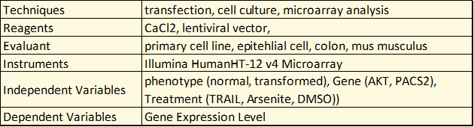
Experimental Metadata Models
Scope: Describe biological and experimental aspects of experiments related to research objects (e.g. how a dataset is generated and what it is about)
Challenges
experiments are complicated, relationships complex, the model is not flat.
incredible diversity of experimental practice and terminology across disciplines
existing models scoped for different use cases (ISA, EBI, KEfED)

Slide 7
State of the Art in Dataset Discovery
Existing Repositories Offer Minimal Support for Experimental Metadata-Based Discovery
“Find datasets that measure the effect of chemical stress on hippocampal action potential activity using patch clamping”
Generic Repositories that cross domains focus on metadata about the RO, but not the studies that produced it
Dryad, Dataverse, Figshare
Domain-specific/community repositories do slightly better, but use underpowered and bespoke models and produce siloed metadata
EBI (Array Express), NCBI (dbGAP, GEO)
Cross domain solutions that support entry of rich, interoperable, semantic experimental metadata don’t really exist

Slide 8
State of the Art in Dataset Discovery
Existing Models are Not Scoped or Structured for Practical Discovery Use Cases and Requirements
OBI (Ontology for Biomedical Investigations) Broad and rich, but focus in on biomedicine, and not suited or being used as a metadata model/schema (too complex, tied to realist view)
ISA (Investigation-Study-Assay) A generic model that is widely used (e.g. Nature Scientific Data), but model is too complex and granular for our needs, and I don’t the RDF translation of their model for publishing LOD seems not fully developed.
KEfED (Knowledge Engineering from Experimental Design) A generic high-level model with right level of abstraction and complexity, but underspecified ontological underpinnings and integration, receives limited use and tailored for data analysis use cases.
EBI (European Bioinformatics Institute RDF Platform) Built for discovery use case, but narrowly scoped for specific EBI systems/domains)
None fit the bill with respect to scope, complexity, focus, integration, and constraints on metadata specification.

Slide 9
Work to Date
1. Landscape Analysis: High level review of models, standards, systems
Outcome: curated dataset to identify relevant and re-usable efforts (link), and detailed evaluation of existing protocol repositories (link)
2. Model Evaluation: Focused analysis of most relevant models and standards
General Metadata: HCLS, DC, DCAT, FOAF, PROV/PAV, . . .
Experimental Metadata: OBI, ISA, KEfED, EBI, CSMO
Outcome: Conclusion that general metadata needs are well supported (link), but no experimental metadata models support our use cases and requirements
3. Requirements and Use Cases: from domain experts, Elsevier, and literature
Outcome: limited set of user stories, competency questions, limited application or workflow requirements (link) . . .more work needed here
4. Reference Terminology and Conceptual Framework: Defined core domain concepts and relationships as shared framework for communication
Outcome: glossary and reference model of experimental activities/artifacts (link)
5. Implementable Metadata Model and Recommendations:
Outcomes:
(1) General Metadata Recommendations (link),
(2) Experimental Metadata Model straw man proposals (below)
Notes:
NOTE THAT THE HYPERLINKS ABOVE ONLY WORK FROM PRESENTATION MODE!!!

Slide 10
Today . . .
Core Experimental Metadata Concepts
Reference Model of Experimental Domain
Experimental Metadata Models
Exemplar Experimental Metadata Records
rdf graph format (concept map)
hierarchical format (pseudo-json)
Notes:
Core Experimental Metadata Concepts
glossary of concepts
ontological type hierarchy of concepts
metadata schema of concepts

Slide 11
Core Experimental Metadata Concepts
Identified ~20 concepts deemed most relevant for an experimental metadata model that is intuitive, generic, extensible, parsimonious, aligned with existing frameworks, and scoped for data entry and discovery
Glossary of Key Concepts
Presents preferred and alternate labels, definition, and significance with respect to modeling and metadata considerations (link)
Hierarchical Models of Key Concepts
An ontological type hierarchy (link) that organizes these concepts to each other according their basic type (material, process, attribute, abstract/information)
A hierarchical metadata schema (link) that organizes these concepts for the purpose of collecting and structuring metadata
Notes:
Elsevier wanted a simple, boiled down summary of what we learned in the from of a small glossary/taxonomy of about 20 concepts deemed most relevant for an experimental metadata model that is intuitive, generic, extensible, parsimonious, aligned with existing frameworks, and scoped for data entry and discovery
Also, a reference domain model that organizes these concepts in a graph according to their real-world relationships.
And a experimental metadata model that organizes these concepts in a graph in a way that best supports efficient metadata creation for our use cases

Slide 12
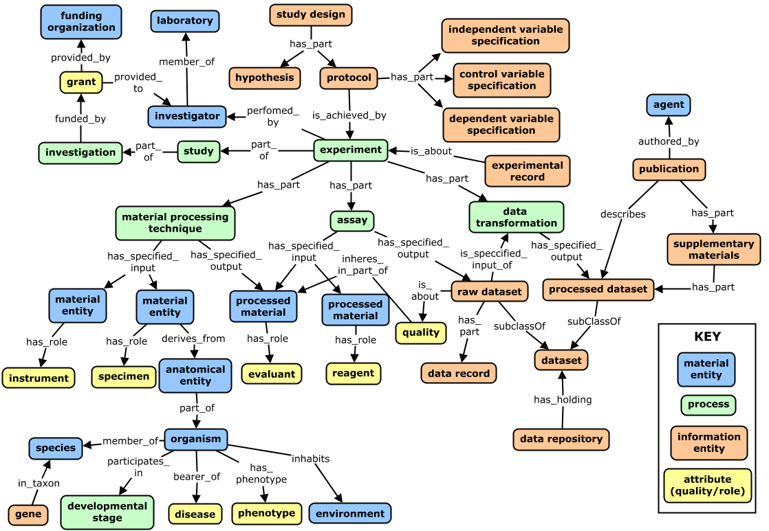
A Reference Model of Core Concepts
Depicts relationships between core domain concepts as they exist in the ‘real world’.
Notes:
This reference model complements the glossary – the goal here being to align our understanding of key concepts in a domain by understanding what they mean and how they are related.
But this perspective is not suited for an implementable model/schema for collecting real metadata.
For this, we need to identify key components, and restructure the model to prioritize them in a way that is efficient/parsimonious but extensible to capture more detail as needed.

Slide 13
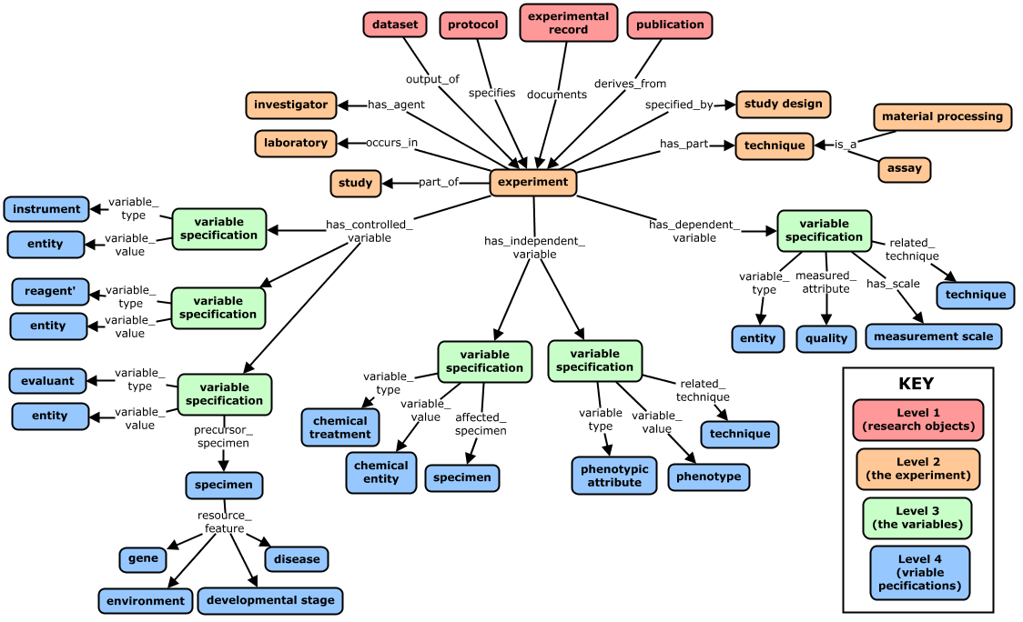
Experimental Metadata Model
(Same graph with alternate coloring to highlight tiers in the model)
Notes:
Here is a view on these same concepts, but organized in a way that makes sense for structuring metadata for entry and discovery use cases. This is the experimental metadata model (don’t dwell long here – it will be more helpful to look at a real example experiment in a couple slides)
This initial model is just a straw man to start knocking against. The exemplar leaf nodes illustrate the types of entities that can plug in as variable types, values, or descriptors.
Different color for each ‘level’ in the model - try to keep to 3-4 levels for ease of data collection and simplifed queries.
Blue nodes can be filled by terms from community CVs/ontologies that can be used as standardized descriptors of variables (e.g. chemical entities could come from ChEBI, techniques from OBI, qualities such from PATO, anatomical entities from Uberon.
Green nodes represent 'variable specifications' that serve as hubs for aggregating information about a given variable that needs to be grouped for answering queries. These contextualize variables, in an extensible way if more detail is desired

Slide 14
Experimental Metadata Model:
A Variable-Centric Approach
Model Captures the central relationship between processes, specimens, and experimental variables
Variables: entities intentionally varied or measured
Dependent variable (measured variable) - entities measured in an assay
Independent variables (factors, parameters): entities (treatments/attributes) on specimens intentionally varied to test affect on dependent variable
Control variables (constants, facilitators)
reagents, instruments that do not vary
characteristics of specimens intentionally held constant
Notes:
These variables represent a universal paradigm that describes how entities participate in an experiment, and captures the aspects most important for researchers to discover, understand, and analyze it on their terms. The fundamental pillar of ‘cause and effect’ that underlies empirical science.
The key point here is that the upper-level structure of the model was built to be generic enough to cover diverse areas of research, as the concepts of controlled, dependent, and independent variables are common across domains. And the properties that hang from these are generic enough to apply across disciplines as well. This supports extensions under this framework for specific disciplines simply by plugging in domain-specific terminologies as values of these properties (and possible specializing the properties for a specific domain).

Slide 15
Exemplar Experiment
Hypothesis: AKT-dependent stress response pathways activate distinct pathways in transformed adenocarcinoma cells vs healthy epithelial cells
Specimen Collection #1: cell collection of normal and transformed colon cells of an Apc<Min/+>[B6] mouse model of colon cancer
Specimen Collection #2: isolated cells used to establish cell culture
Treatment: chemical treatment of cultured cells with DMSO (control) or arsenite (oxidative stressor) at elevated temperatures (42C)
Specimen Collection #3: isolation of mRNA using TRIzol reagent, to obtain mRNA samples from treated cell cultures
Assay: expression microarray analysis performed using an Illumina HumanHT-12 v4 array to identify patterns in level of gene expression
Techniques Specimens Controlled Variables
Independent Variables Dependent Variables

Slide 16
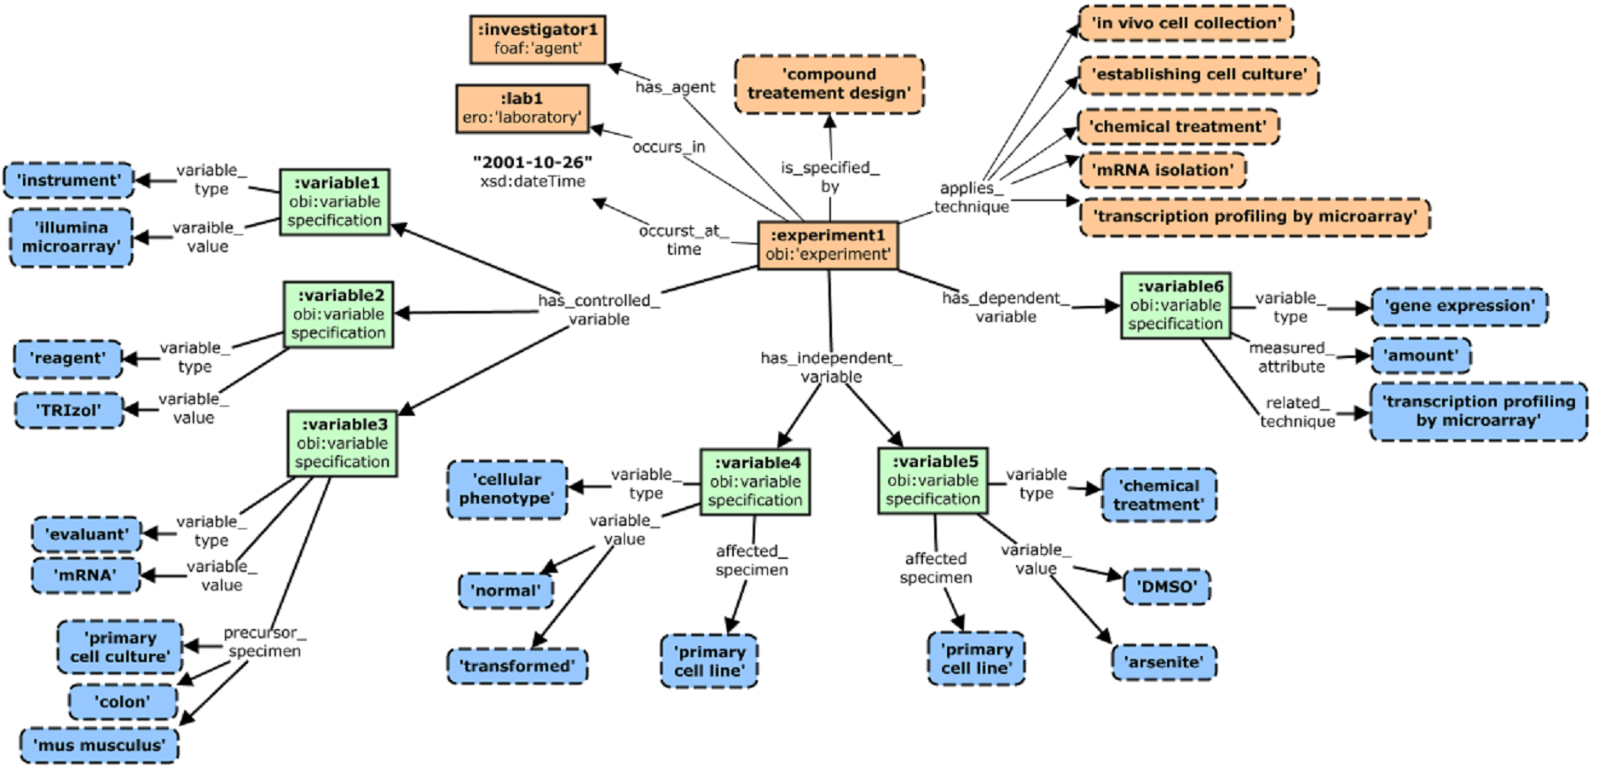
Metadata Record for Exemplar Experiment
This simple model captures minimal essential experimental metadata for core CQs and modeling requirements, and is organized around ‘variable specification’ nodes (green)
Notes:
Different color for each ‘level’ in the model - try to keep to 3-4 levels for ease of data collection and simplified queries.
Rectangles represent instances, rounded boxes represent terms from community CVs/ontologies that can be used as standardized descriptors of variables (e.g. chemicals such as ‘DMSO’ or ‘arsenite’ could come from ChEBI, techniques such as ‘transcriptional profiling by microarray’ from OBI, qualities such as ‘amount’ from PATO, and anatomical entities such as ‘colon’ from Uberon.
Green nodes represent 'variable specifications' that serve as hubs for aggregating information about a given variable that needs to be grouped for answering queries. These contextualize variables, in an extensible way if more detail is desired

Slide 17
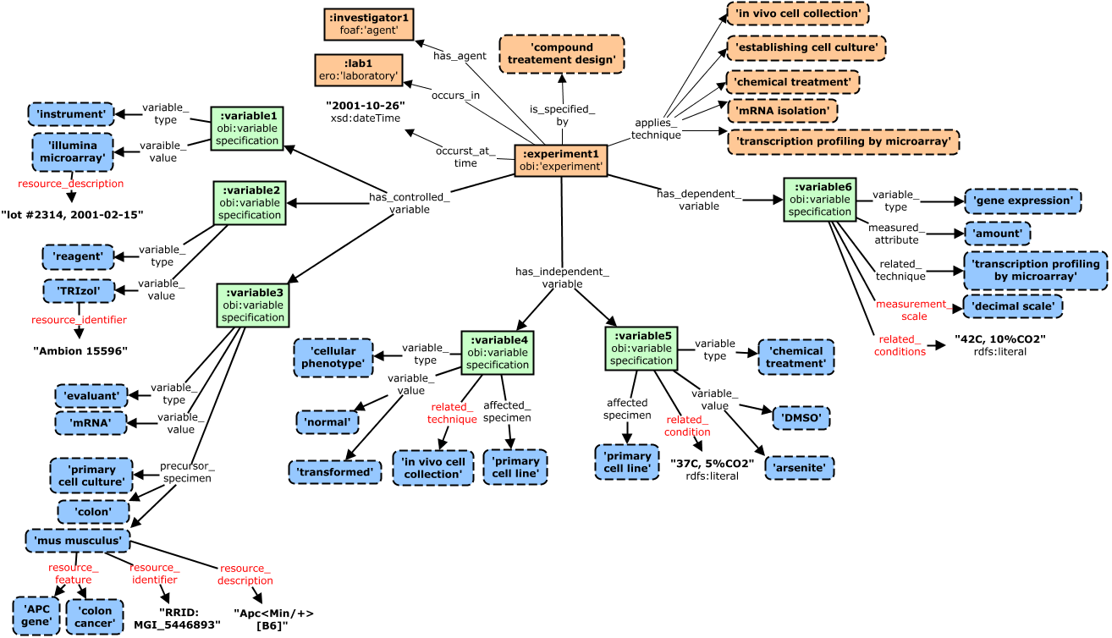
Additional Variable Descriptions
Additional properties can be used to better contextualize variables in the experimental workflow, and provide additional descriptions and identifiers (addied properties in red)
Notes:
Different color for each ‘level’ in the model - try to keep to 3-4 levels for ease of data collection and simplifed queries.
Rectangles represent instances, rounded boxes represent terms from community CVs/ontologies that can be used as standardized descriptors of variables (e.g. chemicals such as ‘DMSO’ or ‘arsenite’ could come from ChEBI, techniques such as ‘transcriptional profiling by microarray’ from OBI, qualities such as ‘amount’ from PATO, and anatomical entities such as ‘colon’ from Uberon.
Green nodes represent 'variable specifications' that serve as hubs for aggregating information about a given variable that needs to be grouped for answering queries. These contextualize variables, in an extensible way if more detail is desired

Slide 18
Model Summary
Different color for each ‘level’ in the model - try to keep to 3-4 levels for ease of data collection and queries.
Rectangles represent instances, rounded boxes represent terms from community CVs/ontologies that can be used as standardized descriptors of variables (e.g. chemicals such as ‘DMSO’ or ‘arsenite’ could come from ChEBI, techniques such as ‘transcriptional profiling by microarray’ from OBI, qualities such as ‘amount’ from PATO, and anatomical entities such as ‘colon’ from Uberon)
Experiment in orange is focal point. Provenance metadata here are about the experiment (not the RO). Note support for 'keyword' type links to techniques/methods applied and experimental designs followed.
Below this we clearly see the focus on our three types of variables.
Green nodes represent 'variable specifications' that serve as hubs for aggregating information about a given variable that needs to be grouped for answering queries. These contextualize variables, in an extensible way if more detail is desired
Independent variables
A key independent variable in our experiment is the cellular phenotype of the source specimens. a variable type link records the general type of thing that is varied, and the variable_value link records the values it takes in the experiment.
Similarly for the chemical treatment variable.
Note that this pattern allow users to find this dataset by searching for experiments where type of chemical treatments is varied, or based on specific chemical values.
Also support for capturing other important information contextualizing how the variable was applied (affected specimen, related techniques or conditions)
Dependent variables
Specification here describes the type of thing that varies (gene expression), and the attribute measured (amount), as well as the technique used for measurement, and related conditions for the measurement
Control/constant variable
These specifications follow similar pattern. They allow description of reagents and devices that are not varied in the experiment, as well as characteristics of the evaluant (the subject of the experiment) and the specimens it is derived from that are held constant.
Note that the model supports additional descriptors and qualifiers to provide additional information about these variables

Slide 19
Key Features and Benefits
Focus is on ‘Experimental Variables’
Beneficial because the notions of controlled, independent, and dependent variables are shared across disciplines
Variable specification instances serve as central organizing nodes that describe variable type and values. This approach abstracts away some details to provide more direct/efficient links from ROs to variable descriptions.
Extensible to record as much context around variables as is needed for a given use case
Related specimens, techniques, conditions can be collected as needed by different applications - but the core value of variable types and values can be collected independently of this other metadata
Imparts low initial curation burden that is scalable for extended use cases
Dependencies ordered so description of primary features (variables) is not dependent on secondary features (processes)
Direct re-use of use community vocabularies/ontologies in variable descriptions
Constrains data entry in variable descriptions, with terms coming from community CVs/ontologies
Model uses community ontologies strictly as ‘referenced taxonomies’, to capture types of entities related to an experiment (rather than typed instances, which increase model complexity and curation burden (SKOS-like approach – could use SKOS in implementation)
Manageable size/complexity
Abstracts away experimental details that are not necessary for core discovery use cases / CQs
e.g. modeling of the set of specimens from which an evaluant derived
Implements a relatively small set of classes and properties, which results in less precise semantics, but simplifies model/data entry, and simplifies queries

Slide 20
Exemplar Metadata Record (~json)
{
dataset_uri: "http://datadryad.org/resource/doi:xx.yyy/dryad.zzzz"
{
experiment:
investigator: agent1
laboratory: lab1
time: "2001-10-26"
study design: compound treatment design
technique: cohort identification
technique: in vivo cell collection
technique: establishing cell culture
technique: chemical treatment
technique: mRNA isolation
technique: transcriptional profiling by microarray
controlled _variable: [
{variable_type: instrument
variable_value: Illumina microarray
resource_description: "lot #2314, 2001-02-15"}
{variable_type: reagent
variable_value: TRIzol
resource_identifier: "Ambion 15596"}
{variable_type: evaluant
variable_value: mRNA
precursor_specimen: primary cell culture
precursor_specimen: colon
precursor_specimen: {
type: mus musculus
resource_feature: colon cancer,
resource_feature: colon cancer,
resource_identifier: "RRID:MGI_5446893"}
}
]
Pseudo-json representation of full metadata record for exemplar experiment
Relatively simple and flat, while capturing needed precision and variable context for core CQs and modeling requirements
Note all values not in “quotes” are terms from community CVs/ontologies
independent_variable: [
{variable_type: cellular phenotype
variable_value: normal
variable_value: transformed
affected_specimen: primary cell line
related_technique: in vivo cell collection}
{variable_type: chemical treatment
variable_value: DMSO
variable_value: arsenite
affected_specimen: primary cell line
related_conditiions: “37C, 5%CO2"}
]
dependent variable: [
{variable_type: gene expression
measured_attribute: amount
related_technique: transcriptional profiling by microarray
measurement_scale: decimal
related_conditiions: "42C, 5%CO2"}
]
}
}
Notes:
a (pseudo) json representation of full metadata record for exemplar experiment might be more accessible to some used to thinking about metadata in this way . . . again, the data is relatively simple and flat, while capturing needed precision and variable context for core CQs and modeling requirements

Slide 21
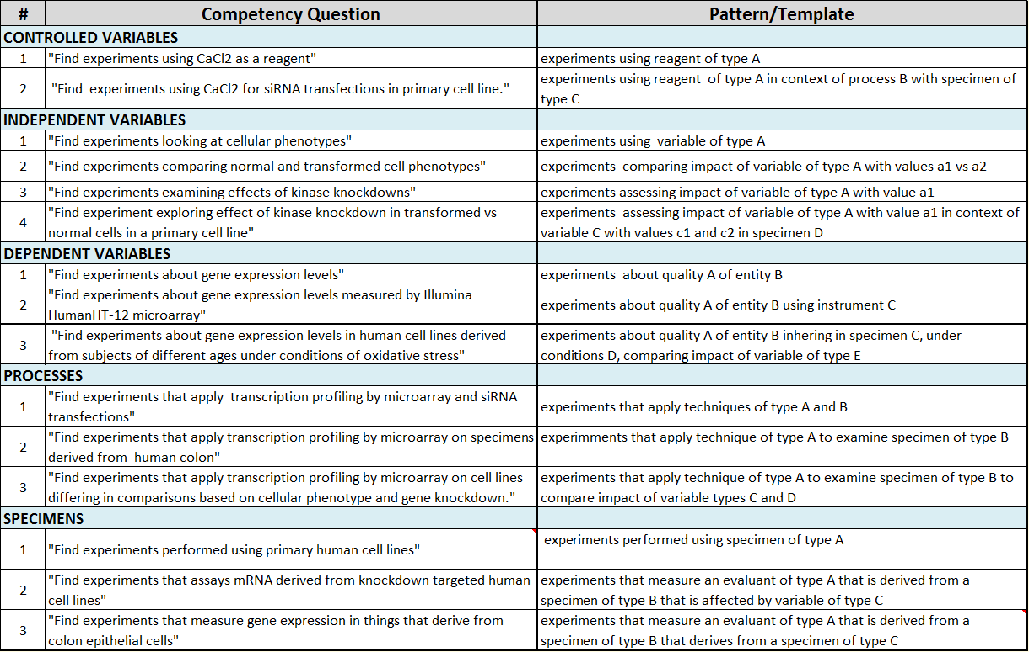
Evaluation Against Competency Questions
Notes:
Note these questions are against a different (but similar) exemplar experiment than the one outline above.

Slide 22
Conclusions and Considerations
I The Model
A variable-centric approach captures most useful metadata in most direct manner, and leverages a universal paradigm that spans disciplines and aligns with existing models.
The core of the model should be intuitive and generic enough to be understood and capture metadata across disciplines, but easily extensible to capture desired level of granularity, and focus on domain-specific concepts where needed. An extensible model also lets you scale the complexity of metadata collection as users adapt to the system.
Leveraging existing community ontologies to record metadata values can pose challenges
identifying and scoping ontologies to use as 'referenced taxonomies‘
curation burden of creating coded data
developing adequate tooling to support structured data entry and search
. . . but also have very big payoffs
consistent and constrained data supports precise and reproducible queries,
the semantics encoded in ontologies are exploited to add value to the data
Notes:
The key point here is that the upper-level structure of the model was built to be generic enough to cover diverse areas of research, as the concepts of controlled, dependent, and independent variables are common across domains. And the properties that hang from these are generic enough to apply across disciplines as well. This supports extensions under this framework for specific disciplines simply by plugging in domain-specific terminologies as values of these properties (and possible specializing the properties for a specific domain).

Slide 23
Conclusions and Considerations
II The Metadata
To be most valuable for data discovery and analysis, experimental metadata should be structured, coded, and semantic.
Structured: Describes defined attributes in discrete elements supports precise queries and analyses
Coded: Captures metadata values using terms from controlled vocabularies to support consistent and rigorous metadata. And the knowledge encoded in these CVs can add value (e.g. synonym and hierarchical query expansion)
Semantic*: When these controlled vocabularies are ontologies, we get a richer and computable knowledge model that can add even more value and be leveraged in many powerful ways (e.g. inferred associations can enhance asserted metadata to support richer set of queries)
This level of metadata of course comes at a cost of building and maintaining complex models, and supporting the increased entry/curation burden with tools and documentation. . . but these barriers here are lessening each year, and the potential value of semantic experimental metadata is growing.
Notes:
*‘Semantic’ – When CVs are structured or better yet, logically encoded like ontologies, we get an underlying knowledge model that can be exploited to add value to the data. This means that not all metadata needs to be asserted explicitly, because knowledge encoded in the ontologies behind-the-scenes can be leveraged in reusable and generalizable ways. For example, if the ontology knows that the PACS2 gene is part of apoptotic pathways, then our example experiment where this gene is recorded as an independent variable can be discovered with queries for experiments where apoptotic features of a specimen are manipulated, without the user having to explicitly assert this in the metadata.

Slide 24
Conclusions and Considerations
III The Tooling
Powerful tools are needed to support the level of structure and consistency we desire from our metadata. Some examples of critical functionality includes:
Vocabulary support for constraining data entry
define custom taxonomy modules from existing high value and high quality vocabularies/ontologies
UI support for data entry
dynamic/reactive presentation of fields based on previous selections
easily browsable hierarchies for finding appropriate values
autocomplete on text entry, with synonym support
tool tips for point of entry instruction, and other contextualized documentation
Semantic / Hierarchical indexing
leverage hierarchical and associative relationships in ontologies to expand queries in useful ways
Query support
for building structured and precise queries and faceting of results

Slide 25
END

Slide 26
Core Experimental Metadata Concepts
Identified ~20 concepts most relevant for an experimental metadata model that is intuitive, generic, extensible, parsimonious, aligned with existing frameworks, and scoped for data entry and discovery
Glossary of Key Concepts
Presents preferred and alternate labels, definition, and significance with respect to modeling and metadata considerations (link)
Hierarchical Models of Key Concepts
An ontological type hierarchy (link) that organizes these concepts to each other according their basic type (material, process, attribute, abstract/information)
A hierarchical metadata schema (link) that organizes these concepts for the purpose of collecting and structuring metadata
Graphical Models of Key Concepts
An ontological reference model that relates these concepts to each other (from a realist, process-based perspective)
An ontological metadata model that relates these concepts in a way more suitable for structuring and querying actual experimental metadata.
Notes:
Elsevier wanted a simple, boiled down summary of what we learned in the from of a small glossary/taxonomy of about 20 concepts deemed most relevant for an experimental metadata model that is intuitive, generic, extensible, parsimonious, aligned with existing frameworks, and scoped for data entry and discovery
Also, a reference domain model that organizes these concepts in a graph according to their real-world relationships.
And a experimental metadata model that organizes these concepts in a graph in a way that best supports efficient metadata creation for our use cases

